Slide 1

Done by sathies kumar.A

Slide 2

INTRODUCTION To MySQL
MySQL :
MySQL is a database management system. A database is a structured collection of data. It may be anything from a simple shopping list to a picture gallery or the vast amounts of information in a corporate network. To add, access, and process data stored in a computer database, you need a database management system such as MySQL Server. Since computers are very good at handling large amounts of data, database management systems play a central role in computing, as standalone utilities, or as parts of other applications.

Slide 3
DBMS Vs RDBMS
Database Management Systems (DBMS) are software systems used to store, retrieve, and run queries on data. A DBMS serves as an interface between an end-user and a database, allowing users to create, read, update, and delete data in the database.
The software used to store, manage, query, and retrieve data stored in a relational database is called a relational database management system (RDBMS). The RDBMS provides an interface between users and applications and the database, as well as administrative functions for managing data storage, access, and performance.

Slide 4
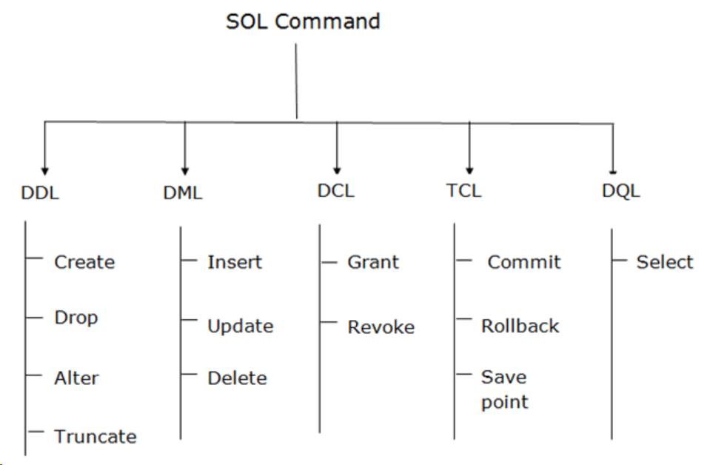
Types of Commands
There are five types of SQL commands:
DDL
DML
DCL
TCL
DQL.

Slide 5
DDL Commands
DDL changes the structure of the table like creating a table, deleting a table, altering a table, etc.
All the command of DDL are auto-committed that means it permanently save all the changes in the database.
Here are some commands that come under DDL:
CREATE
ALTER
DROP
TRUNCATE

Slide 6
DML Commands
DML commands are used to modify the database. It is responsible for all form of changes in the database.
The command of DML is not auto-committed that means it can't permanently save all the changes in the database. They can be rollback.
Here are some commands that come under DML:
INSERT
UPDATE
DELETE

Slide 7
DCL Commands
DCL commands are used to grant and take back authority from any database user.
Here are some commands that come under DCL:
Grant
Revoke

Slide 8
TCL Commands
TCL commands can only use with DML commands like INSERT, DELETE and UPDATE only.
These operations are automatically committed in the database that's why they cannot be used while creating tables or dropping them.
Here are some commands that come under TCL:
COMMIT
ROLLBACK
SAVEPOINT

Slide 9
DQL Commands
DQL is used to fetch the data from the database.
It uses only one command:
SELECT

Slide 10
Primary Key & Foreign Key
The key differences between the primary key and foreign key is that, the primary key is about uniquely identifying records within a table, while the foreign key establishes relationships between tables and enables the linking of data across multiple tables.
Both keys play crucial roles in maintaining data integrity, consistency, and relational structure in a database.
Primary Key:
A primary key is a unique identifier for each record in a table.
Foreign Key:
A foreign key establishes a relationship between tables by referencing the primary key of another table.

Slide 11
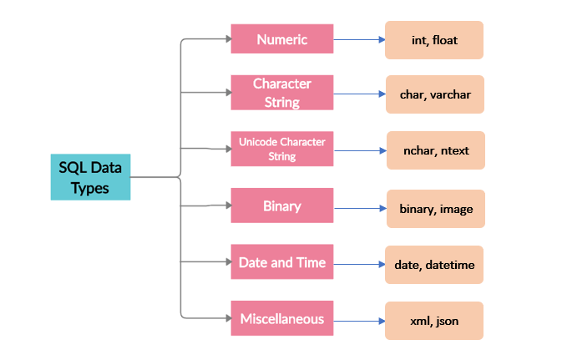
Types of Datatypes
Numeric Datatype
String Datatype
Date & Time Datatype

Slide 12
String Datatypes
String Datatypes:-
Char: A FIXED length string (can contain letters, numbers, and special characters). The size parameter specifies the column length in characters - can be from 0 to 255. Default is 1
Varchar: A VARIABLE length string (can contain letters, numbers, and special characters). The size parameter specifies the maximum string length in characters - can be from 0 to 65535
Binary: Equal to CHAR(), but stores binary byte strings. The size parameter specifies the column length in bytes. Default is 1
Varbinary: Equal to VARCHAR(), but stores binary byte strings. The size parameter specifies the maximum column length in bytes.

Slide 13
String Datatypes
Tiny blob: For BLOBs (Binary Large Objects). Max length: 255 bytes
Tiny text: Holds a string with a maximum length of 255 characters
Medium blob: For BLOBs (Binary Large Objects). Holds up to 16,777,215 bytes of data
Medium Text: Holds a string with a maximum length of 16,777,215 characters
Blob: For BLOBs (Binary Large Objects). Holds up to 65,535 bytes of data
Text: Holds a string with a maximum length of 65,535 bytes
Long blob: For BLOBs (Binary Large Objects). Holds up to 4,294,967,295 bytes of data
Long text: Holds a string with a maximum length of 4,294,967,295 characters

Slide 14
Numeric Datatypes
Numeric Datatypes:-
Bit: A bit-value type. The number of bits per value is specified in size. The size parameter can hold a value from 1 to 64. The default value for size is 1.
Tiny int: A very small integer. Signed range is from -128 to 127. Unsigned range is from 0 to 255. The size parameter specifies the maximum display width (which is 255)
Bool: Zero is considered as False, Non-Zero is considered as True.
Boolean: Equal to Bool
Small int: A small integer. Signed range is from -32768 to 32767. Unsigned range is from 0 to 65535. The size parameter specifies the maximum display width (which is 255)
Medium int: A medium integer. Signed range is from -8388608 to 8388607. Unsigned range is from 0 to 16777215. The size parameter specifies the maximum display width (which is 255)

Slide 15
Numeric Datatypes
Int: A medium integer. Signed range is from -2147483648 to 2147483647. Unsigned range is from 0 to 4294967295. The size parameter specifies the maximum display width (which is 255)
Integer: Equal to INT(size)
Big int: A large integer. Signed range is from -9223372036854775808 to 9223372036854775807. Unsigned range is from 0 to 18446744073709551615. The size parameter specifies the maximum display width (which is 255)
Float (Size, d): A floating point number. The total number of digits is specified in size. The number of digits after the decimal point is specified in the d parameter. This syntax is deprecated in MySQL 8.0.17, and it will be removed in future MySQL versions.

Slide 16
Numeric Datatypes
Float: A floating point number. MySQL uses the p value to determine whether to use FLOAT or DOUBLE for the resulting data type. If p is from 0 to 24, the data type becomes FLOAT(). If p is from 25 to 53, the data type becomes DOUBLE()
Double: A normal-size floating point number. The total number of digits is specified in size. The number of digits after the decimal point is specified in the d parameter
Decimal: An exact fixed-point number. The total number of digits is specified in size. The number of digits after the decimal point is specified in the d parameter. The maximum number for size is 65. The maximum number for d is 30. The default value for size is 10. The default value for d is 0.
Dec: Equal to DECIMAL(size,d)

Slide 17
Date & Time Datatypes
Date and Time Datatypes:
Date: A date. Format: YYYY-MM-DD. The supported range is from '1000-01-01' to '9999-12-31'
DateTime: A date and time combination. Format: YYYY-MM-DD hh:mm:ss. The supported range is from '1000-01-01 00:00:00' to '9999-12-31 23:59:59'. Adding DEFAULT and ON UPDATE in the column definition to get automatic initialization and updating to the current date and time
TimeStamp: A timestamp. TIMESTAMP values are stored as the number of seconds since the Unix epoch ('1970-01-01 00:00:00' UTC). Format: YYYY-MM-DD hh:mm:ss. The supported range is from '1970-01-01 00:00:01' UTC to '2038-01-09 03:14:07' UTC. Automatic initialization and updating to the current date and time can be specified using DEFAULT CURRENT_TIMESTAMP and ON UPDATE CURRENT_TIMESTAMP in the column definition

Slide 18
Date & Time Datatypes
Time: A time. Format: hh:mm:ss. The supported range is from '-838:59:59' to '838:59:59’
Year: A year in four-digit format. Values allowed in four-digit format: 1901 to 2155, and 0000. MySQL 8.0 does not support year in two-digit format.

Slide 19

Database Creation and use
This is to create a database which is to be used for storing the datas.
The Command:
create database database_name;
use database name;
Syntax:
Output:

Slide 20
Table Creation
This command is used to create a table.
The Command:
create table table_name;
Syntax:
Output:

Slide 21

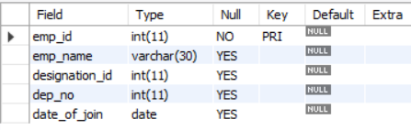
Describing a Table
This command is used to describe the table with its properties and column
details with its data types.
The Command:
describe table_name;
Syntax:
Output:

Slide 22
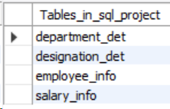
Show Tables in a Database
This Command is used to show number of table in a particular database.
The Command:
show tables;
Syntax:
Output:

Slide 23
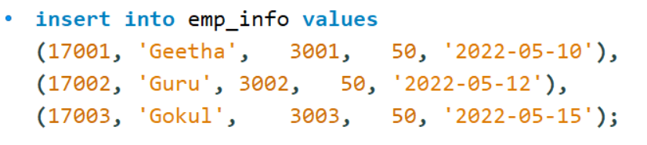
Inserting Values to a Table
This command is used to insert values into the table.
The Command:
insert into table_name value (value_column_name1, value_column_name2, value_column_name3, value_column_name4);
Syntax:
Output:

Slide 24

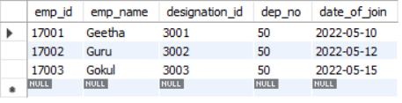
Display Table with Values
This command is used to display the values of the table.
The command:
select * from table_name;
Syntax:
Output:

Slide 25
Altering a Table
This command is used to alter a table.
We can Alter table in multiple ways:
Add
Modify
Drop
update
The Command:
alter table table_name add Column_name datatype;
alter table table_name modify Column_name datatype;
update table_name set Column_name = ‘Value’ where column_name = ‘Value’ ;
alter table table_name drop Column_name;

Slide 26
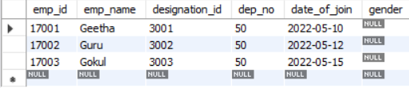
Adding a Column
This column is used to Add a column in a existing table.
The Command:
alter table table_name add column_name datatype;
Syntax:
Output:

Slide 27
Modify a Table
This command is used to Modify a Table.
The Command:
alter table table_name modify column_name;
Syntax:
Output:

Slide 28
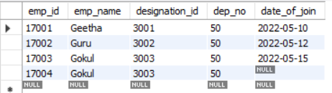
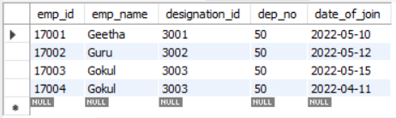
Updating a Table
This command is used to Update a Table.
The Command:
update table_name set Column_name = ‘Value’ where column_name = ‘Value’ ;
Syntax:
Output:
Before After

Slide 29
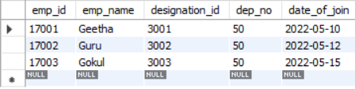
Deleting a Value
This command is used to delete a specific value from a table.
The Command:
delete from table_name where column_name = ‘Value’;
Syntax:
Output:
Before After

Slide 30
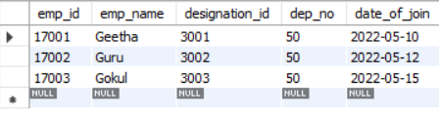
Dropping a Column
This command is used to drop a specified column in the existing table.
The Command:
alter table table_name drop column column_name;
Syntax:
Output:

Slide 31
String Functions
Lcase
Ucase
Left
Right
Concat
Trim
Char Length
Mid
Length

Slide 32
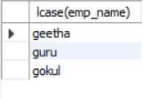
Lcase
This command is used to display all the characters in lower case.
The Command:
select lcase(column_name) from table_name;
Syntax:
Output:

Slide 33

Ucase
This command is used to display all the characters in Upper case.
The Command:
select ucase(column_name) from table_name;
Syntax:
Output:

Slide 34
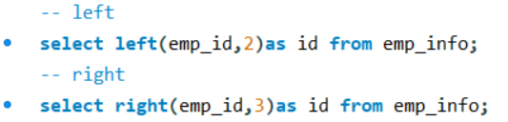


Left & Right
This command is used to display the specified characters from a data on either sides.
The Command:
select left(column_name, 2) , right(column_name, 2) from table_name;
Syntax:
Output:
left right

Slide 35
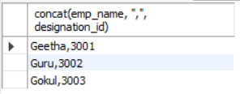
String Concatenation
This command is used to Concatenate two strings.
The Command:
select concat(Column_Name1, Column_Name2) from table_name;
Syntax:
Output:

Slide 36
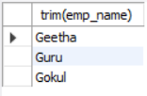
Trim
This command is used to trim the unwanted space and characters of the value.
The Command:
select trim(column_name) from table_name;
Syntax:
Output:

Slide 37
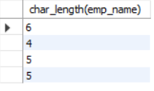
Char Length
This command is used to find the length of the characters of a string.
The Command:
select char_length(column_name) from table_name;
Syntax:
Output:

Slide 38
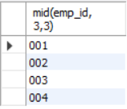
Mid
This Command is used to find the middle part of the characters in a string.
The Command:
select mid(Column_name, 3,2) from table_name;
Syntax:
Output:

Slide 39
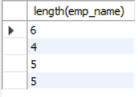
Length
This command is used to find the total length of the characters in a string.
The Command:
select length(column_name) from table_name;
Syntax:
Output:

Slide 40
General Functions
Where
Or
And
In
Not In
Greater Than & Lesser Than
Greater Than or Equal to
Lesser Than or Equal To
<> (Not In)
!
Count
Distinct
Between
Count with Distinct
Order by Asc and Desc
Group By
Limit & Desc Limit
Like & Not Like

Slide 41
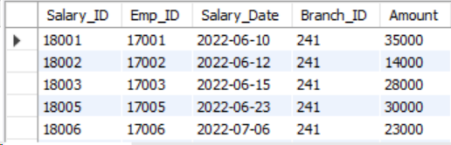
Where
This command is used to find the details of a specified value of a column.
The Command:
select * from table_name where column_name = ‘Value’;
Syntax:
Output:

Slide 42
Or, And, In
Or: This Command is used to find the details when any one condition is true among the multiple conditions.
And: This Command is used to find the details when all the conditions are true.
In: This command is used to find the details when all the conditions are true and is a easy way.
The Command:
Or: select * from table_name where column_name1 = value or column_name2 = value;
And: select * from table_name where column_name1 = value and column_name2 = value;
In: select * from table_name where column_name in (Values);

Slide 43
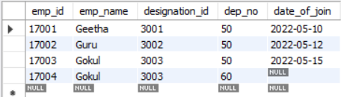


Or, And, In
Syntax:
Or:-
And:-
In:-
Output:
or And In

Slide 44
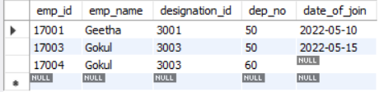
Not In
This command will display the values except the values we give in the condition.
The Command:
select * from table_name where column_name not in (value1, value2);
Syntax:
Output:

Slide 45
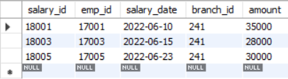
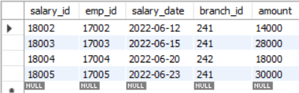
Greater Than and Lesser Than
The Command:
Greater than:- select * from table_name where column_name > value;
Lesser than:- select * from table_name where column_name < value;
Syntax:
Greater Than:-
Lesser Than:-
Output:
Greater Than:- Lesser Than:-

Slide 46

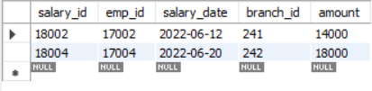
Greater Than or Equal To and Lesser Than or Equal To
The Command:
Greater than:- select * from table_name where column_name >= value;
Lesser than:- select * from table_name where column_name <= value;
Syntax:
>=:-
<=:-
Output:
>= :- <= :-

Slide 47

Count
This command is used to count the total number of values in the table.
The Command:
select count(*) from table_name;
Syntax:
Output:

Slide 48
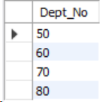
Distinct
This command is used to display distinct values.
The Command:
select distinct(column_name) from table_name;
Syntax:
Output:

Slide 49
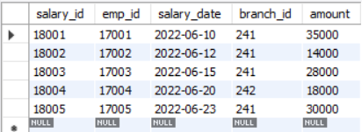
Between
This command is used to display the values between or in the range of two values.
The Command:
select * from table_name where column_name between value1 and value2;
Syntax:
Output:

Slide 50

Count with Distinct
This command is used to count the total number of values distinctly.
The Command:
select count(Distinct(column_name)) from table_name;
Syntax:
Output:

Slide 51

Group By
This command is used to group the values based on the condition.
The Command:
select * from table_name group by column_name;
Syntax:
Output:

Slide 52
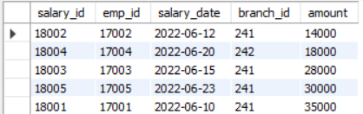
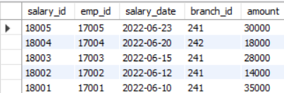
Order by Asc & Desc
This command is used to order the values in an order of either ascending or descending.
The Command:
Asc:- select * from table_name order by column_name;
Desc:- select * from table_name order by column_name desc;
Syntax:
Asc:-
Desc:-
Output: Asc Desc

Slide 53
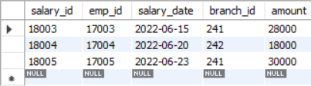
Limit
This command is used to display the values to a limited level.
The Command:
select * from table_name limit 2,5;
Syntax:
Output:

Slide 54
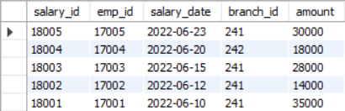
Desc Limit
This command is used to display the values in a descending order of limit mentioned.
The Command:
select * from table_name desc limit 10,5;
Syntax:
Output:

Slide 55
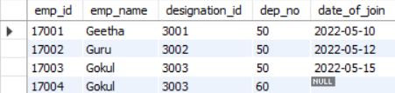
Like
The Command:
select * from table_name where column_name like ‘%value’ or ‘value&’ or ‘%value%’;
Syntax:
Output:

Slide 56
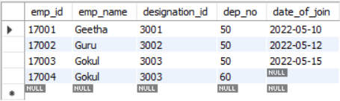
Not Like
The Command:
select * from table_name where column_name not like ‘%value%’;
Syntax:
Output:

Slide 57
Date & Time Functions
Month
Year
Date
Now
Date – Format
Datediff
TimeStampDiff

Slide 58
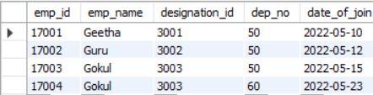
Month
This command is used to display the month of a date value.
The command:
select * from table name where month(date_of_join) = 05;
Syntax:
Output:

Slide 59
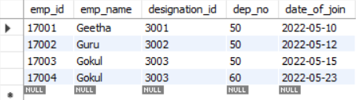
Year
This Command is used to display the year of the date value.
The Command:
select * from table name where year(date_of_join) = 2022;
Syntax:
Output:

Slide 60
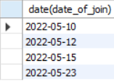
Date
This command used to display a date value.
The Command:
select date(column_name) from table_name;
Syntax:
Output:

Slide 61
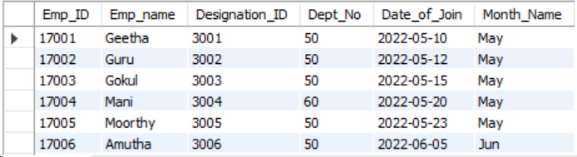
Date - Format
The Command:
select *, date_format(Column_Name, ‘%b’) as Month_name from table_name;
Syntax:
Output:

Slide 62
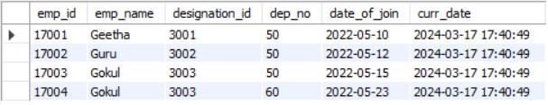
Now
The Command:
select *, now() as name from table_name;
Syntax:
Output:

Slide 63
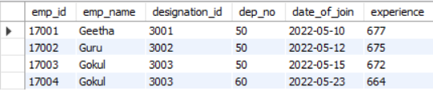
Datediff
The Command:
select *, timestampdiff(year, column_name, current_date()) as Experience from table_name;
Syntax:
Output:

Slide 64
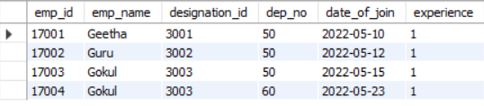
Timestampdiff
The Command:
select *, timestampdiff(year, column_name, current_date()) as Experience from table_name;
Syntax:
Output:

Slide 65

Calculated Functions
Sum
Max
Min
Average
Round

Slide 66

Max
The Command:
select max(column_name) from table_name;
Syntax:
Output:

Slide 67

Sum
The Command:
select sum(column_name) from table_name;
Syntax:
Output:

Slide 68

Min
The Command:
select min(Column_name) from table_name;
Syntax:
Output:

Slide 69

Average
The Command:
select avg(column_name) from table_name;
Syntax:
Output:

Slide 70

Round
The Command:
select round(avg(column_name),0) from table_name;
Syntax:
Output:

Slide 71
Join Functions
Inner Join
Left Join
Right Join
Full Join
Cross Join
Case end

Slide 72
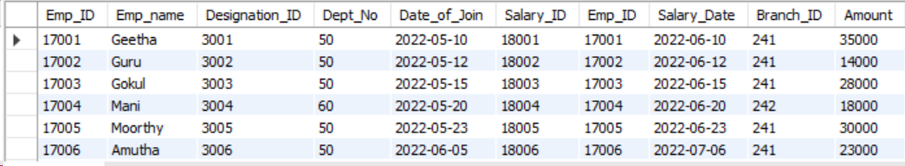
Inner Join
The Command:
select * from table_name1 inner join table_name2 on table_name1.column_name1 = table_name2.column_name2;
Syntax:
Output:

Slide 73
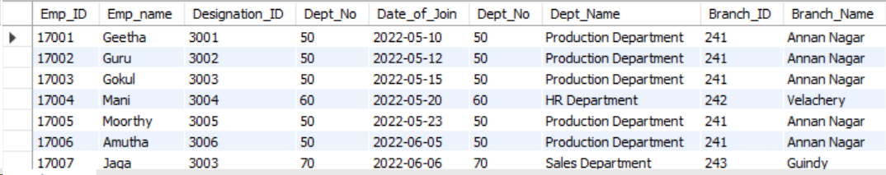
Left Join
The Command:
select * from table_name1 left join table_name2 on table_name1.column_name1 = table_name2.column_name2;
Syntax:
Output:

Slide 74
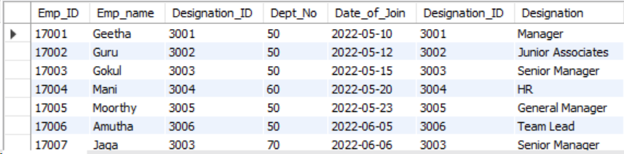
Right Join
The Command:
select * from table_name1 right join table_name2 on table_name1.column_name1 = table_name2.column_name2;
Syntax:
Output:

Slide 75
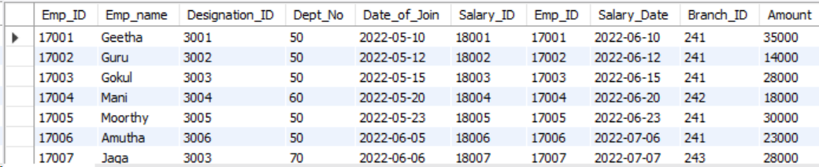
Full Join
The Command:
(select * from table_name1 left join table_name2 on table_name1.column_name1 = table_name2.column_name2) Union (select * from table_name1 right join table_name2 on table_name1.column_name1 = table_name2.column_name2);
Syntax:
Output:

Slide 76
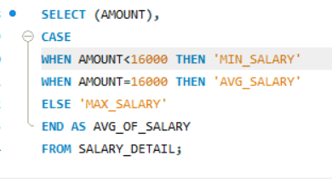
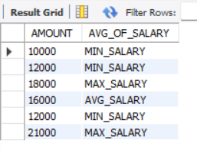
Case end
QUERY :
Syntax:
CASE
WHEN condition1 THEN result1
WHEN condition2 THEN result2
WHEN condition3 THEN result3
ELSE result
END;
Output:

Slide 77
Logical Functions
If
Count If

Slide 78
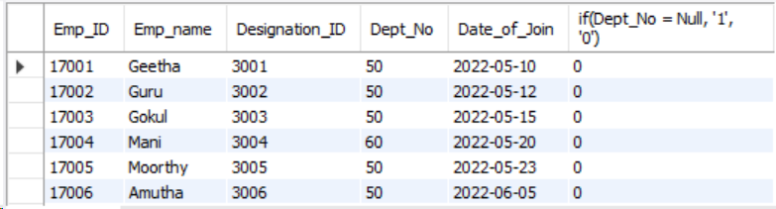
IF
The Command:
select *, if (column_name = ‘value’ , ‘if state’, ‘else state’) from table_name;
Syntax:
Output:

Slide 79
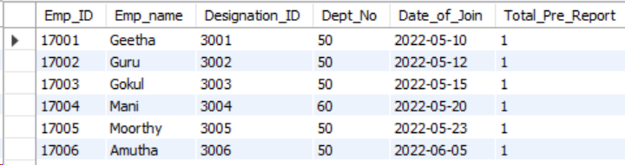
Count If
The Command:
select *, count(if(column_name = ‘value’, ‘ifstate’, ‘elsestate’)) from table_name;
Syntax:
Output:

Slide 80
Delimiter
A delimiter is a special character used to signal the end of a SQL statement. The most commonly used delimiter in MySQL is the semicolon (;), which is used to separate statements from one another.
The Command:
delimiter //
Some Code
end //
delimiter ;

Slide 81
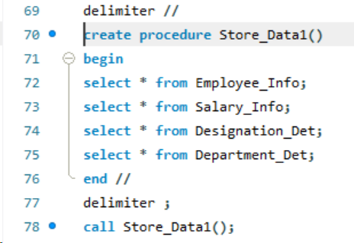
Procedure
Syntax: Output:

Slide 82
Triggers
create trigger [trigger_name]
[before | after]
{insert | update | delete}
on [table_name]
[for each row]
[trigger_body]

Slide 83
Types
Before Insert
Before Update
Before Delete
After Insert
After Update
After Delete

Slide 84
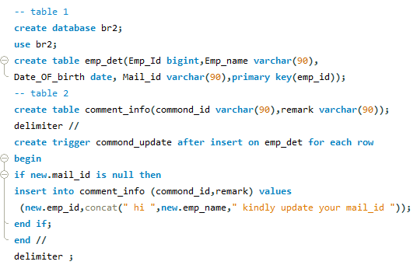
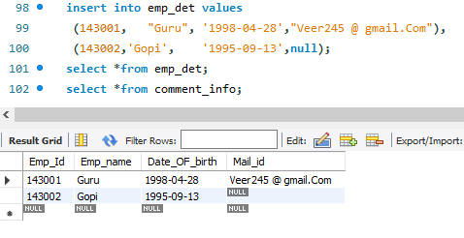

Before Insert Trigger
Syntax :
Output:

Slide 85



After Insert Trigger
Syntax :
Output:

Slide 86
Before update Trigger
Syntax :
Output:

Slide 87

Before update Trigger
Output:

Slide 88



After update Trigger
syntax :

Slide 89



After update Trigger
Output:
Output: After update data present into second table

Slide 90


Trigger ( Before Delete )
QUERY :

Slide 91




Trigger ( Before Delete )
Output :
Output: delete data present into backup of second table

